Slide 1
Rail Optimizer : EDI / API Process
Created By: Amol Erande - EXT

Slide 2

Introduction
Electronic Data Interchange (EDI) is the computer-to-computer exchange of business documents in a standard electronic format between business partners.

Slide 3
204 Inbound
Inbound Messages – RO receive messages from Customers/Vendors.
Specifies the type of EDI transaction set being received, in this case, the Motor Carrier Load Tender.
Initiating Customer Orders:
We use EDI 204 to start the process of creating customer orders
Running a Database Script:
Retail Order Specifics:
We create equipment numbers: These are unique identifiers for the items being ordered.
Success Message Confirmation:
Verifying Customer Order Creation:

Slide 4

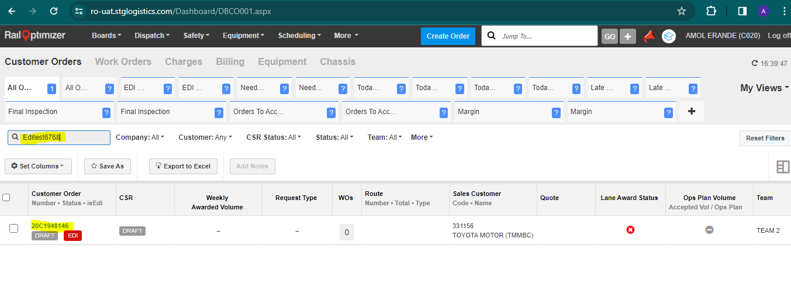
Demo on UI
--Verify EDI Inbound Message processing
204I
Required Field:-
Reference No – EDI@Test
Equipment No.-STTU747271
Business partner ID- 331156
Company code- C020
Type – Order (New)

Slide 5
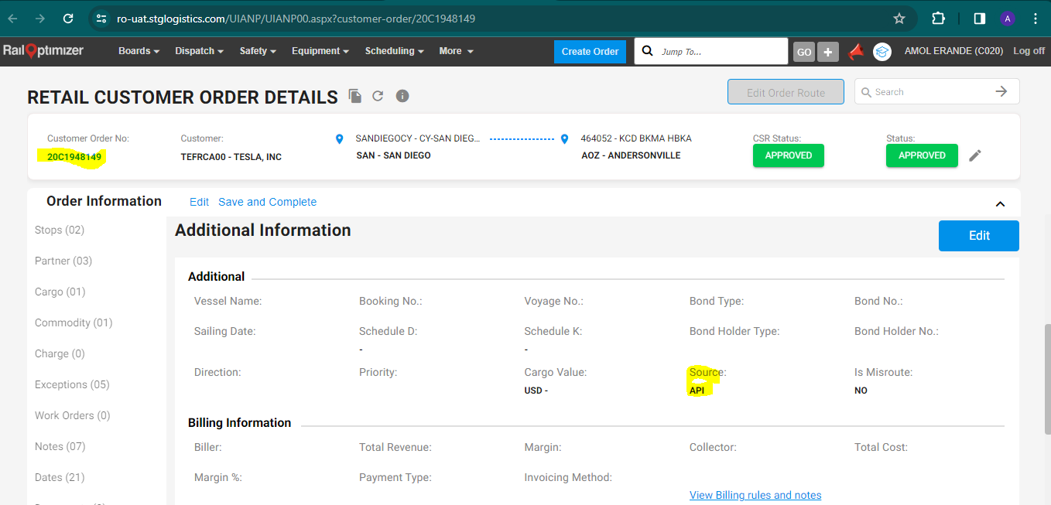
Create The CO using API
Tesla Customer
Other Customer
This enhances operational efficiency by reducing manual input and streamlining the order fulfillment process.
API integration enables real-time updates, providing accurate and timely information on order status, inventory levels, and shipment details.

Slide 6
Additional Information:

Slide 7
1.Components
RO EDI Engine is a batch processing framework that is used for EDI message processing, RFQ to Quote interfacing, Invoice processing etc. This has been used as a common engine for all the legacy batch processing needs in RO. Some of the processes where this engine is currently used are
Inbound and Outbound EDI message processing
RFQ to quote interfacing
Invoice processing
Order Exceptions
Accessorial Calculations

Slide 8
2.Description On RO
204 Inbound – Motor Carrier Load Tender
210 Inbound – Motor Carrier Freight Details And Invoice
214 Inbound – Transportation Carrier Shipment Status Message
227 Inbound – Trailer Usage Report
315 Inbound – Status Details
322 Inbound – Terminal operations and Intermodal Ramp Activity
350 inbound – Customs Status Information
410 inbound – Rail Carrier Freight Details And Invoice

Slide 9
3.GE Appliances
GE LT: This comes and creates a CO GE BL: This updates the CO with the equipment#. GE MT: This takes CO to an empty status.

Slide 10
Any Questions

Slide 11
Thank You
Created By: Amol Erande - EXT

